Slide 1
Digging Into Movie Posters
Movie posters analysis based on CNN and CD algorithm
Group3
Chen Yiyan Wu Longfei
Yan Shiqin Zhang Yanshu

Slide 2
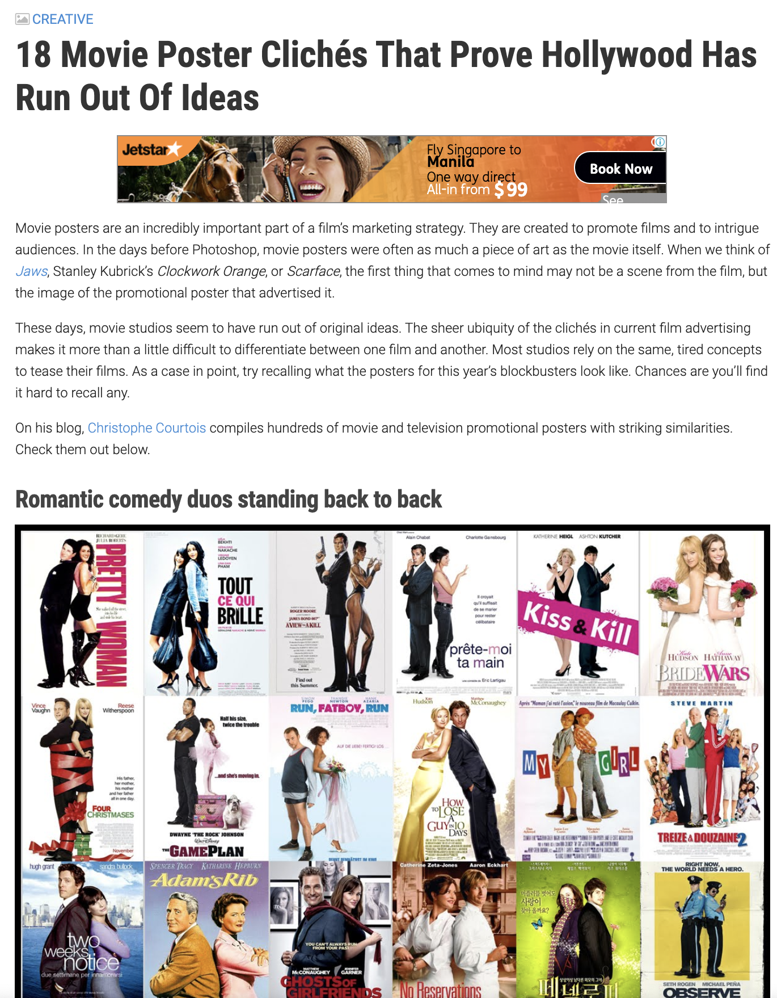

Slide 3
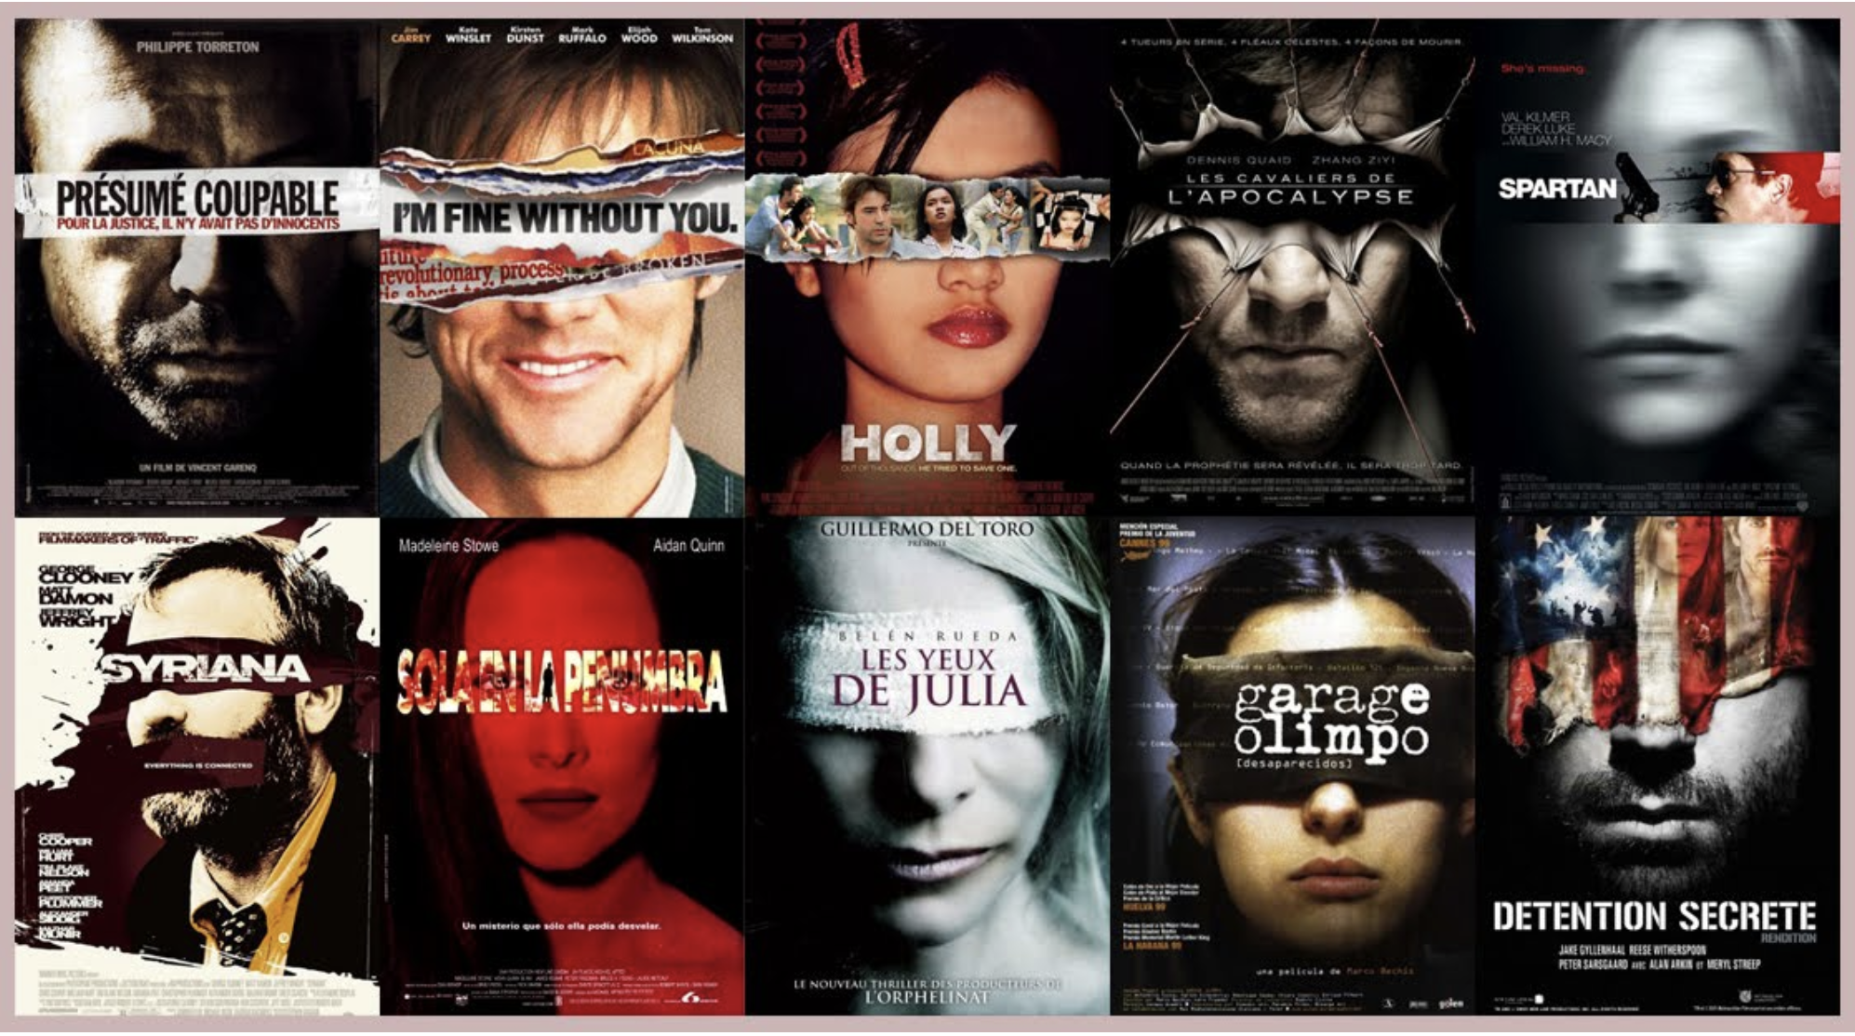
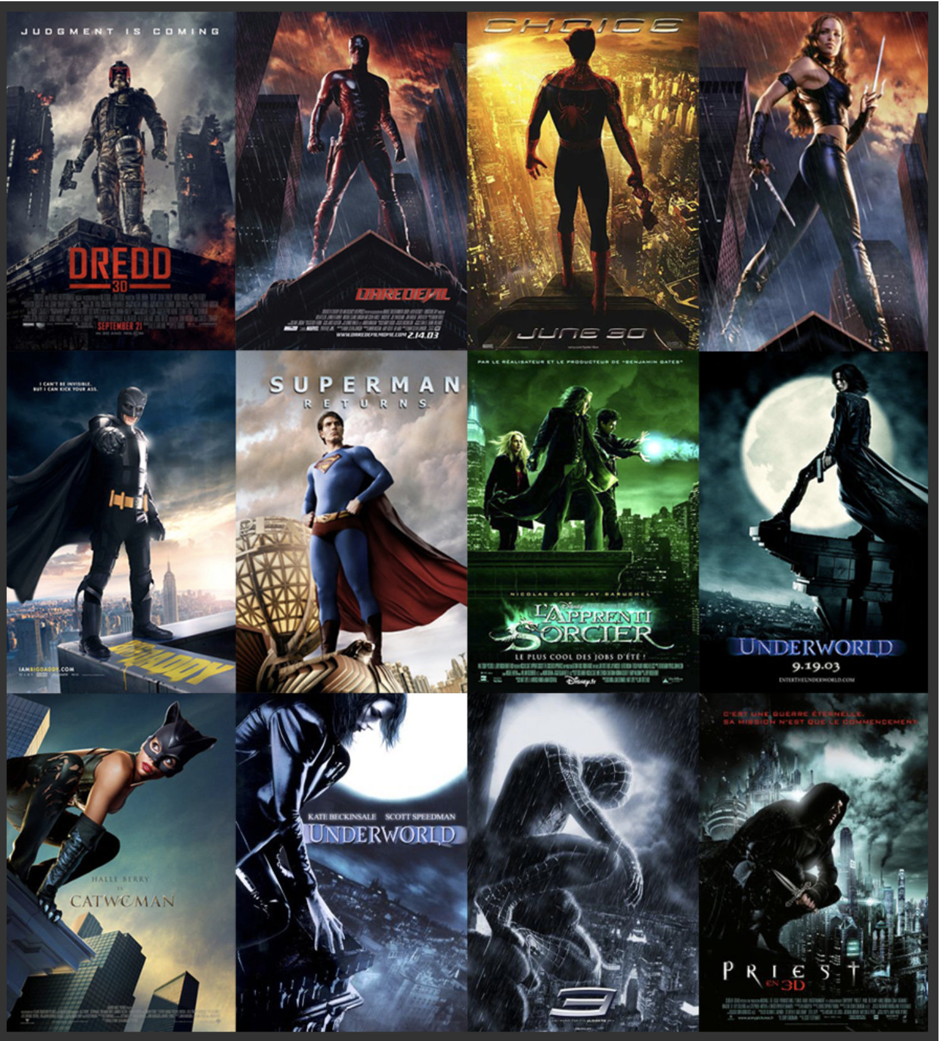
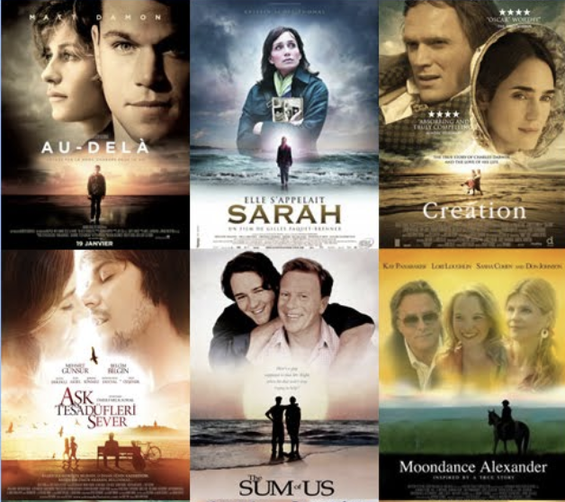
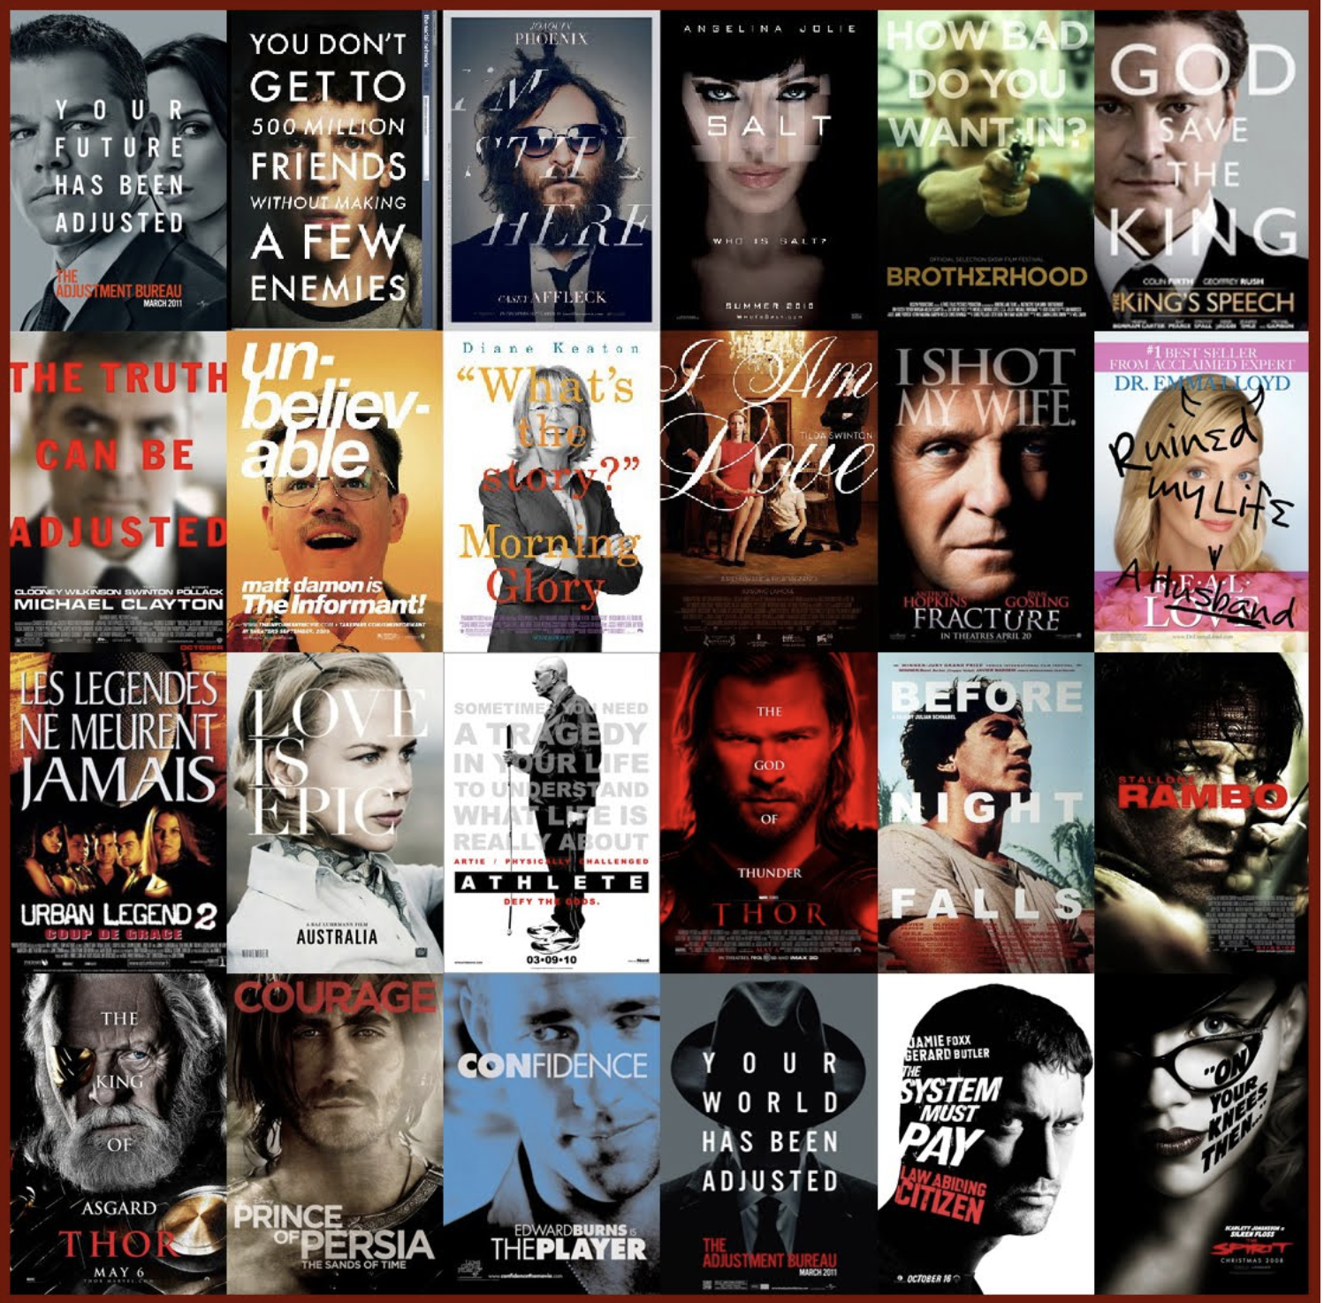
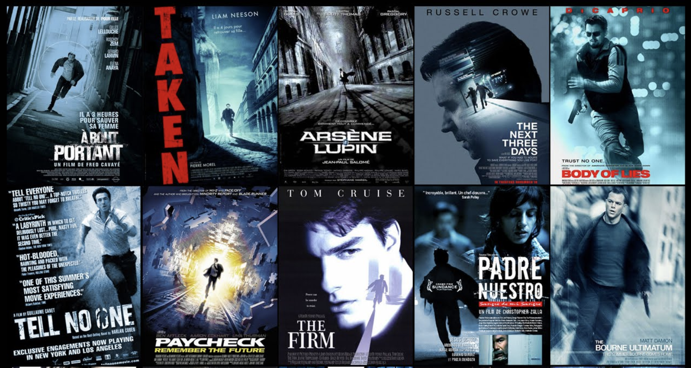
Has poster designers in Hollywood run out of ideas?

Slide 4
Purpose of study
Verify the existence of poster designing cliche.
Find out some common design style among movie posters.

Slide 5
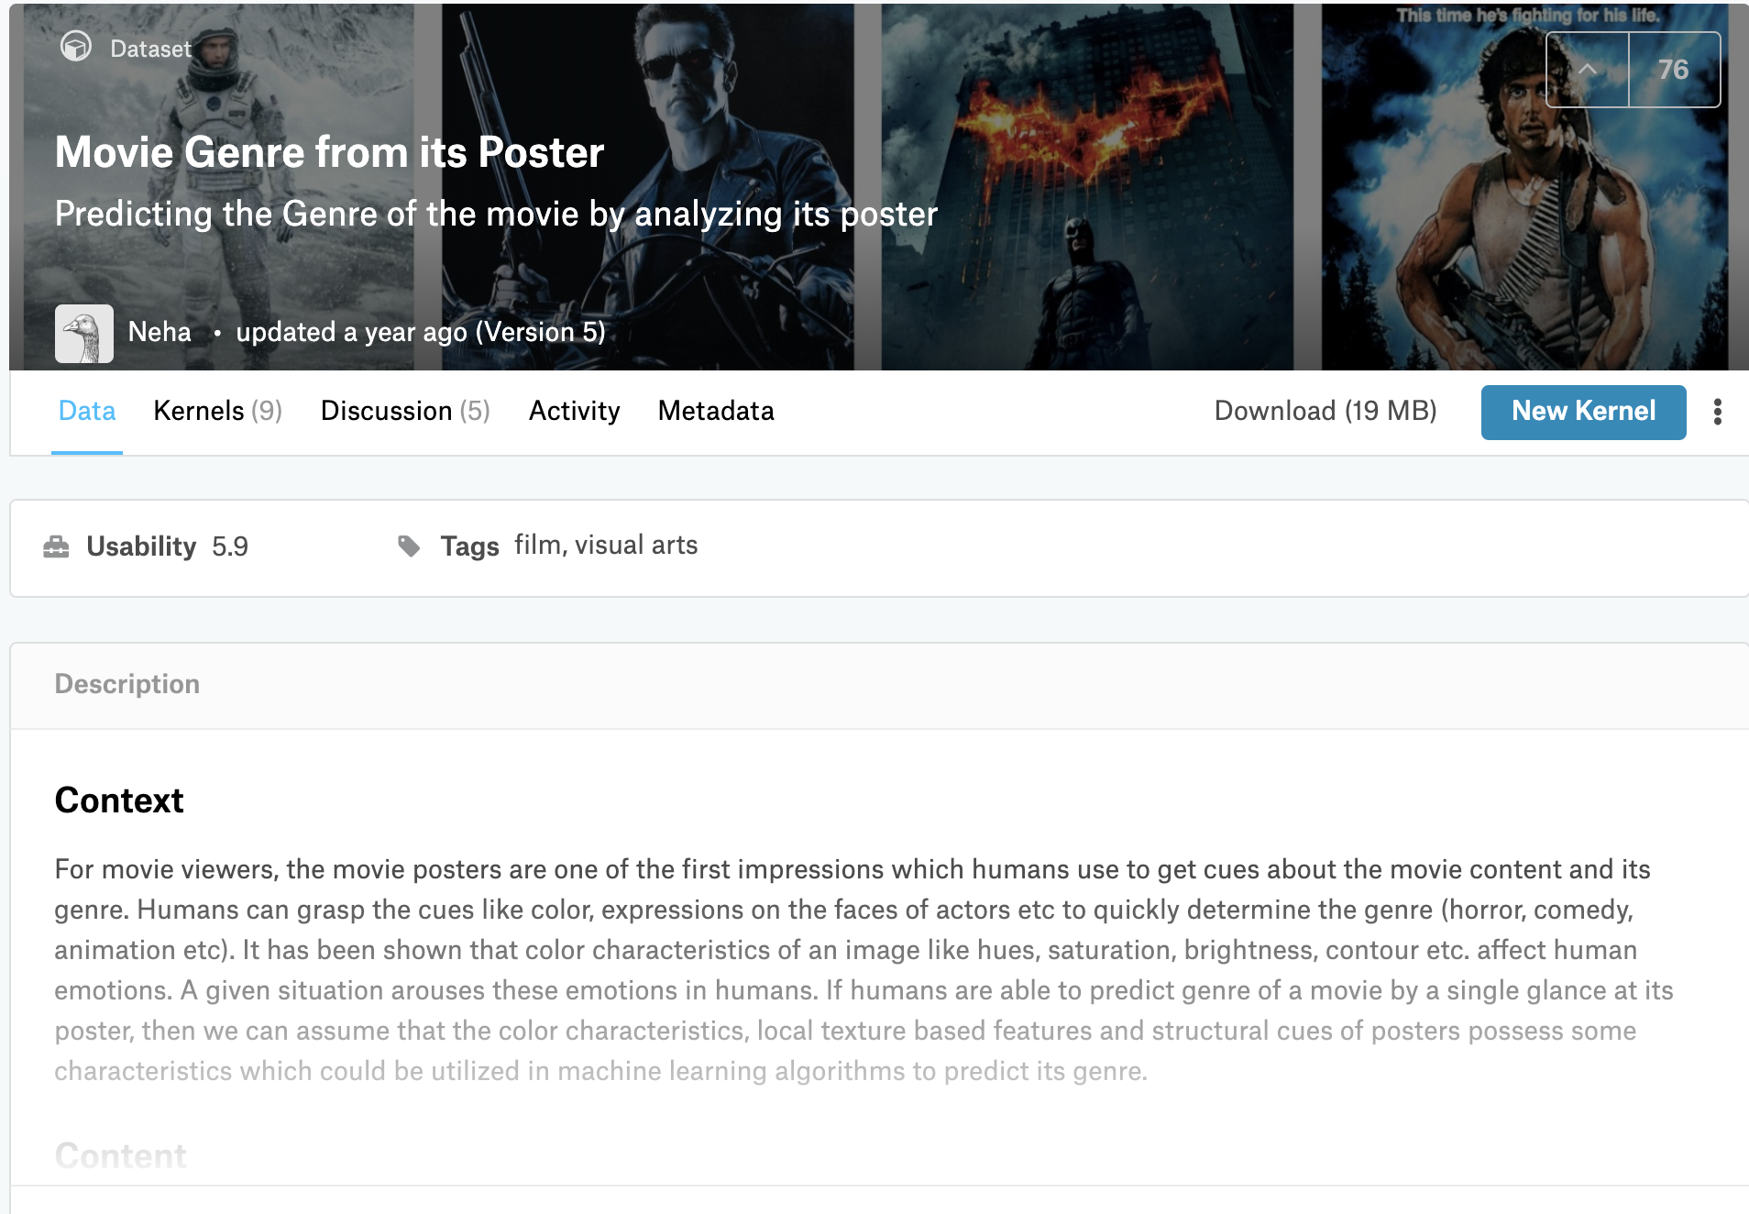

Data source
Dataset: <Movie Genre from its Poster> from kaggle.com
Poster Images
Movie Infos

Slide 6

Workflow
Generate New Poster
(Neural Style Transfer)
Calculate dissimilarity
(Histogram + CNN)
Analyze Community and Visualization (Neo4j)
Form Graph
Community Detection

Slide 7
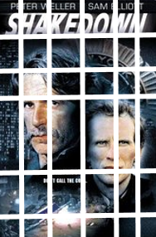
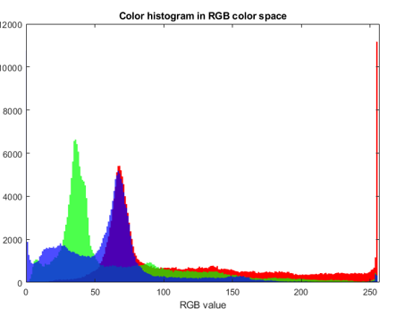
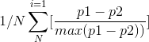
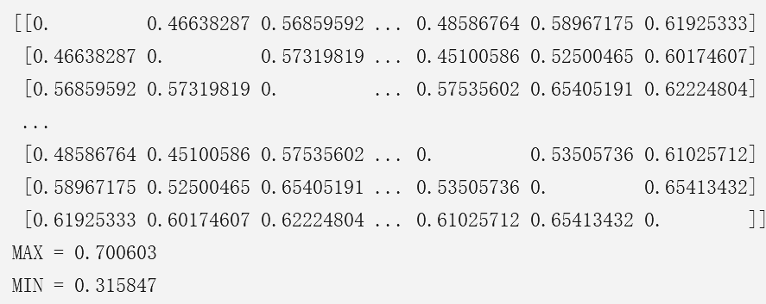
Calculate Dissimilarity —— Histogram
Matrix 1

Slide 8

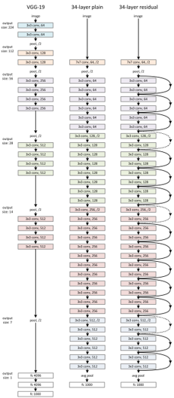
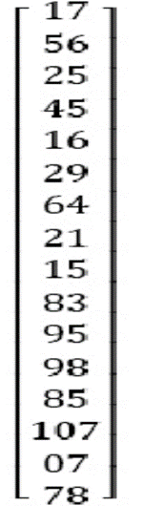
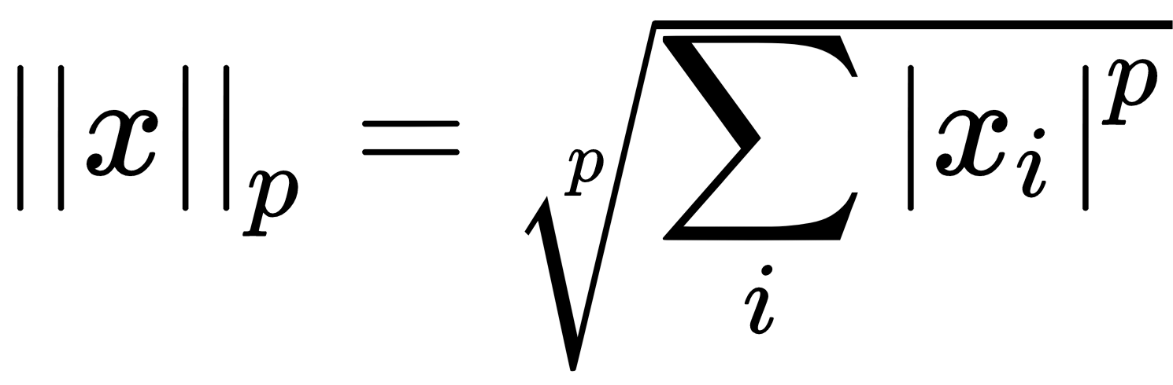
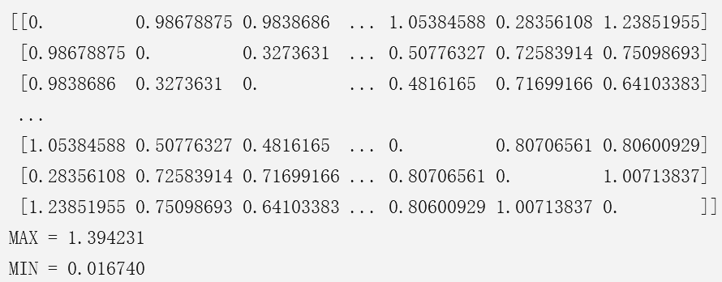
Calculate Dissimilarity —— CNN
Matrix 2

Slide 9
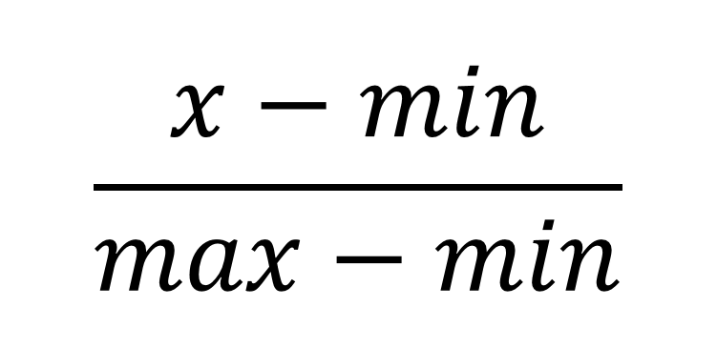
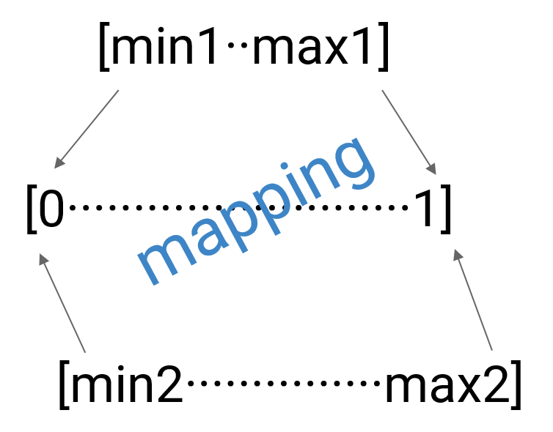
Combine 2 Matrix —— Standardization

Slide 10
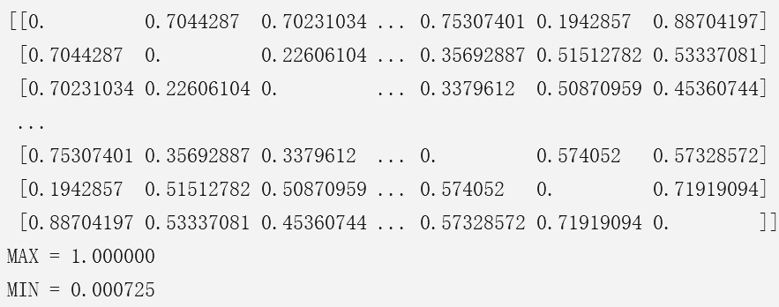
Combine 2 Matrix
Combined Matrix
= alpha × Matrix 1
+ (1-alpha) × Matrix 2
where alpha ∈ [0, 1]

Slide 11
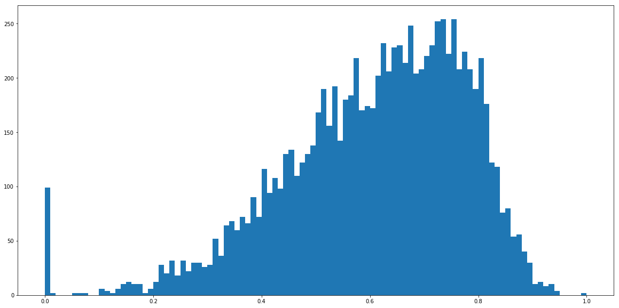
Dissimilarity Score Distribution
smallest threshold for every node to have an edge:
0.59

Slide 12
CD Algorithms
Algorithms we used:
Girvan Newman
Greedy Modularity
K Clique
Asyn Fluid (only in connected graph)

Slide 13
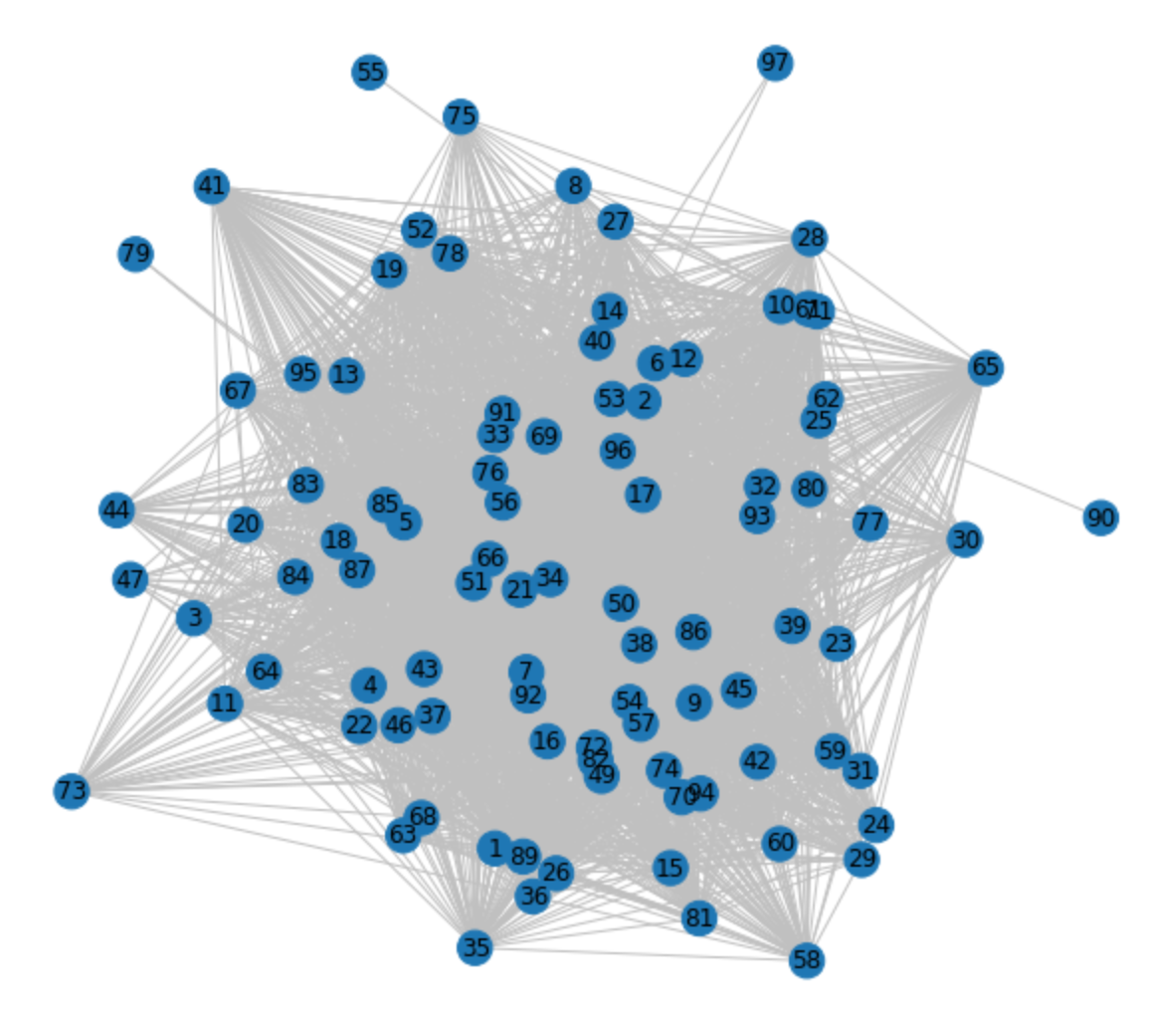
Build Graph
Set threshold to 0.59

Slide 14

CD Algorithms —— GN & K Clique
They all look like this !

Slide 15
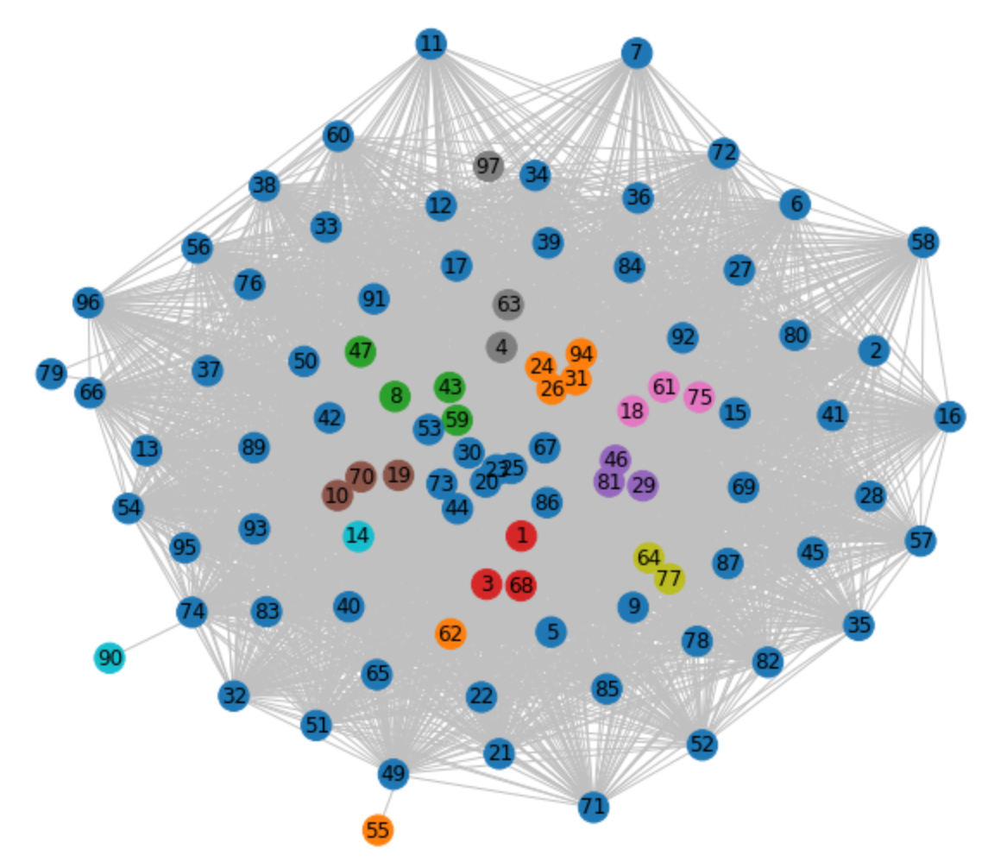
CD Algorithms —— Greedy Modularity
Note the BLUE nodes around !

Slide 16
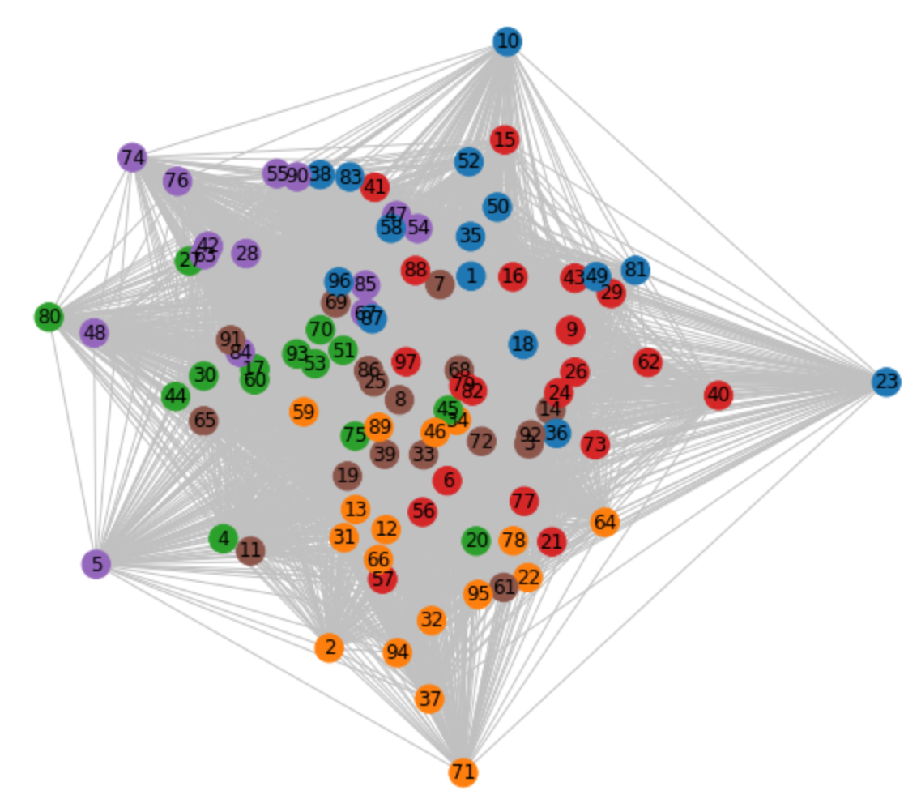

CD Algorithms —— Asyn Fluid
Quite GOOD,
right ？

Slide 17
CD Algorithms —— Draw A Conclusion
Algorithm | Performance
Girvan Newman | ×
Greedy Modularity | —
K Clique | ×
Asyn Fluid | √

Slide 18
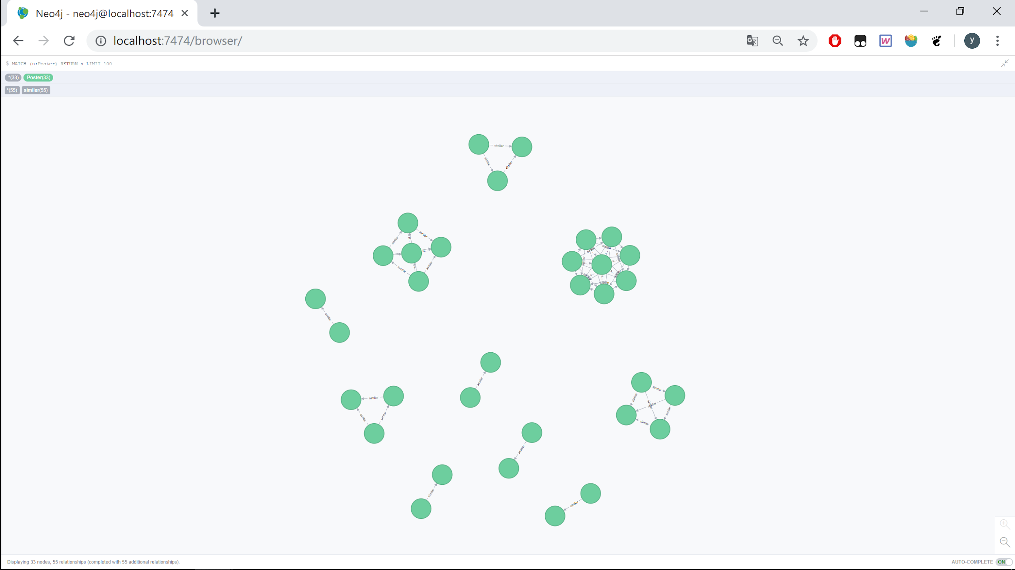
Use Neo4j to Visualize

Slide 19
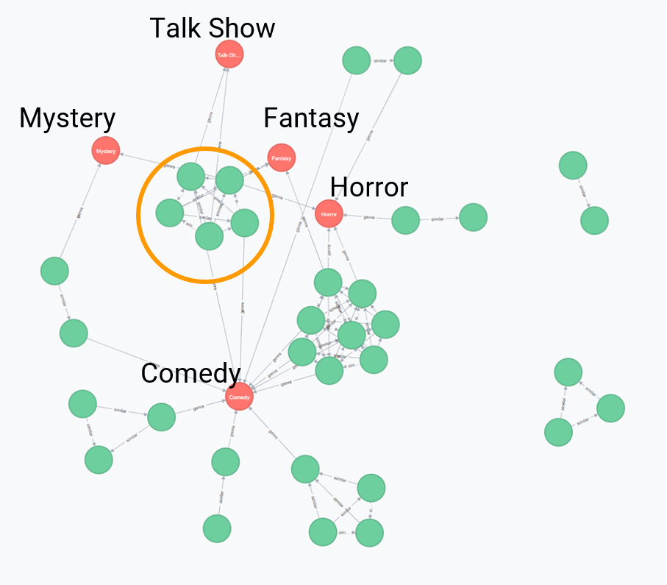
Use Neo4j to Visualize
Then we can analyze the relationship between different clusters

Slide 20
Data selection & results
Two questions mentioned before
Does cliche really exist?
Is there any relations between movie content and its poster?

Slide 21
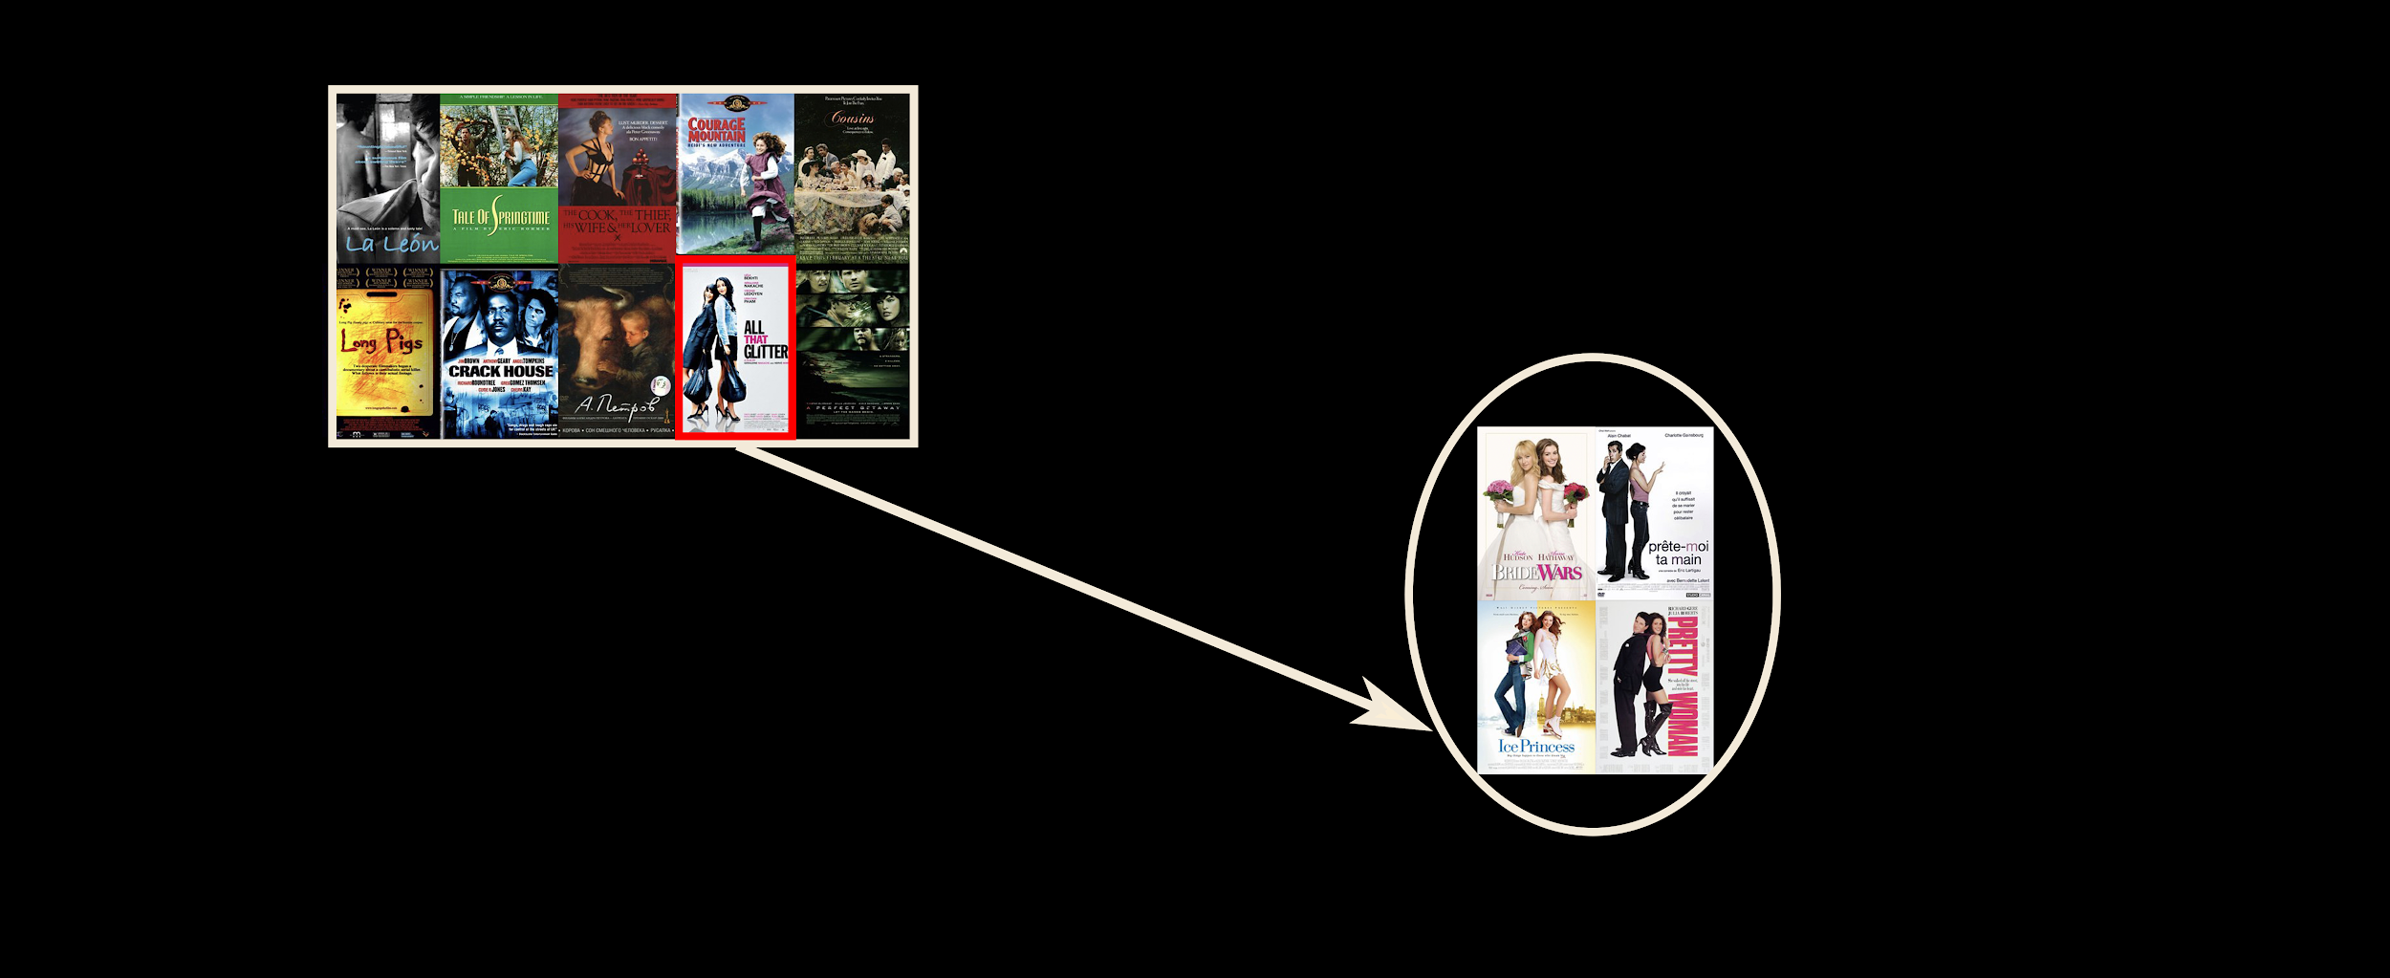
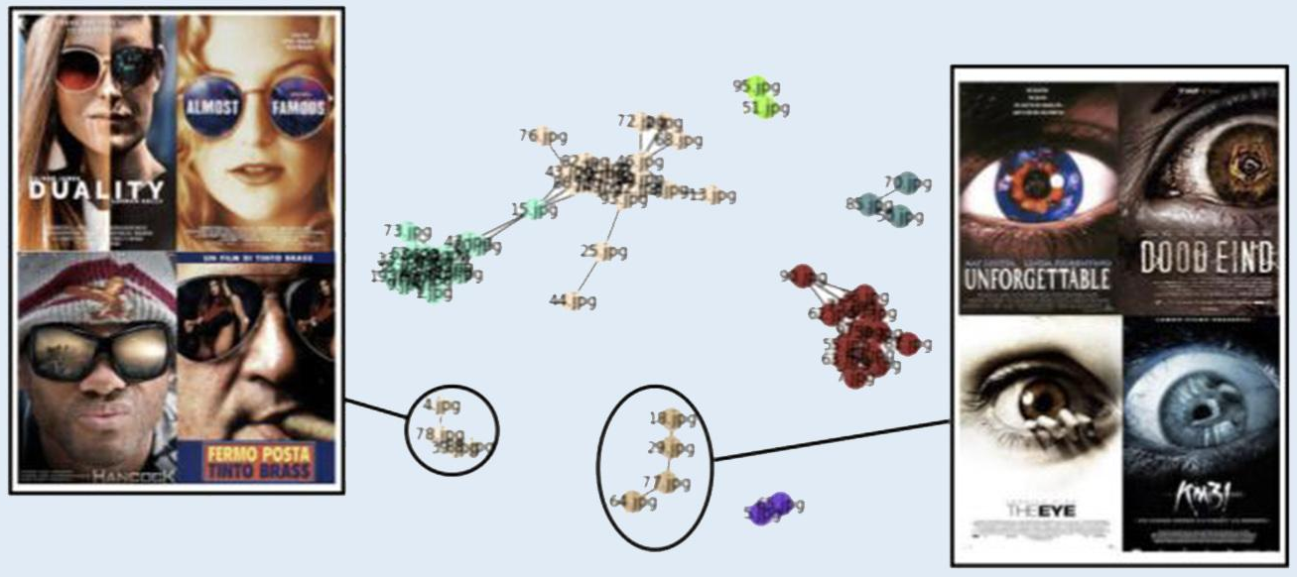
Does cliche exist?
Manually select several classes of visually similar posters.
2. Add plenty of random posters
Notes:
One more picture to show some communities increases after inputting more posters

Slide 22
Any relations between posters and movie contents?
Hypotheses:
Production time
Genre
From same movie series (e.g. MARVEL)

Slide 23
Production time
Movie is a reflection of the society. Movie posters from the same time may be affected by culture and social background.
Input posters from different times.
Observe whether posters from the same time form a community.
Notes:
result

Slide 24
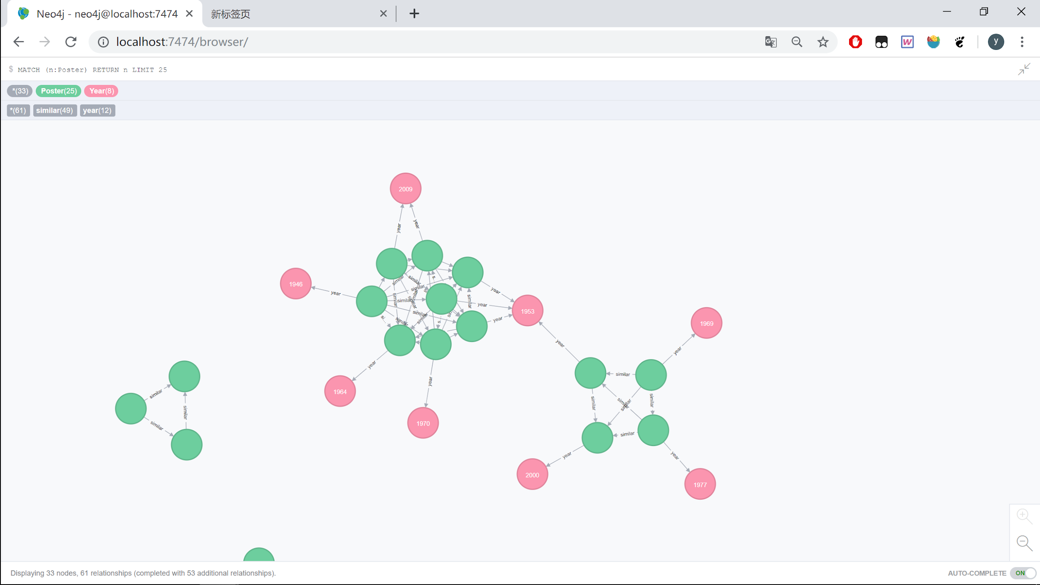
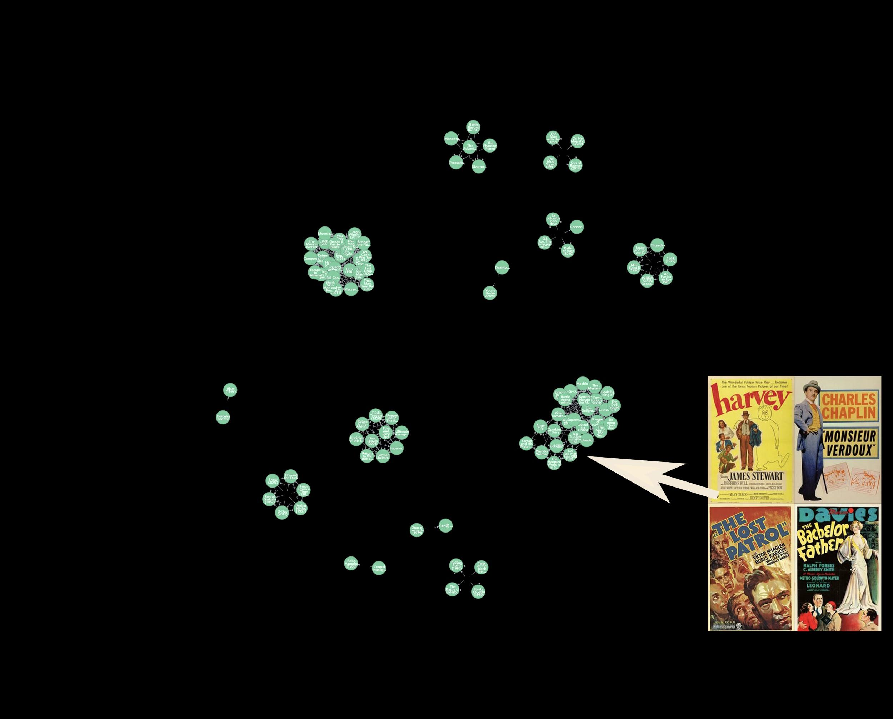
Movie contents are not strongly related to the production time. However, particular relation still exists, especially among the old movies.

Slide 25
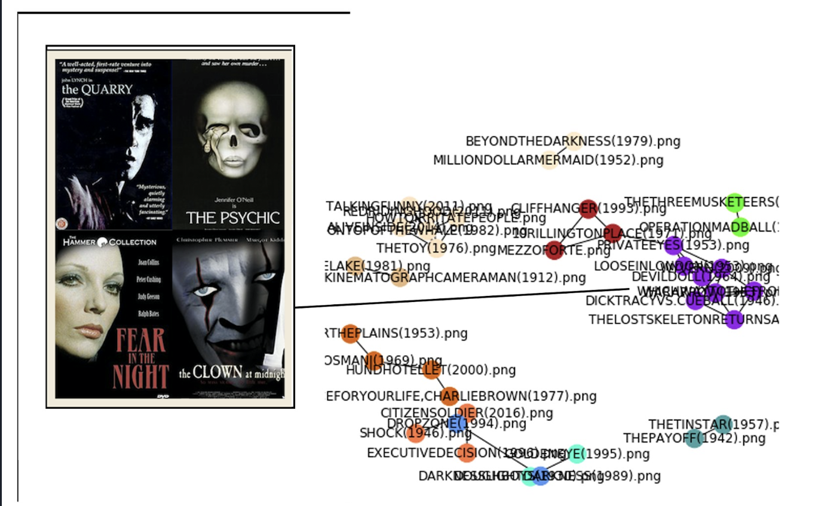
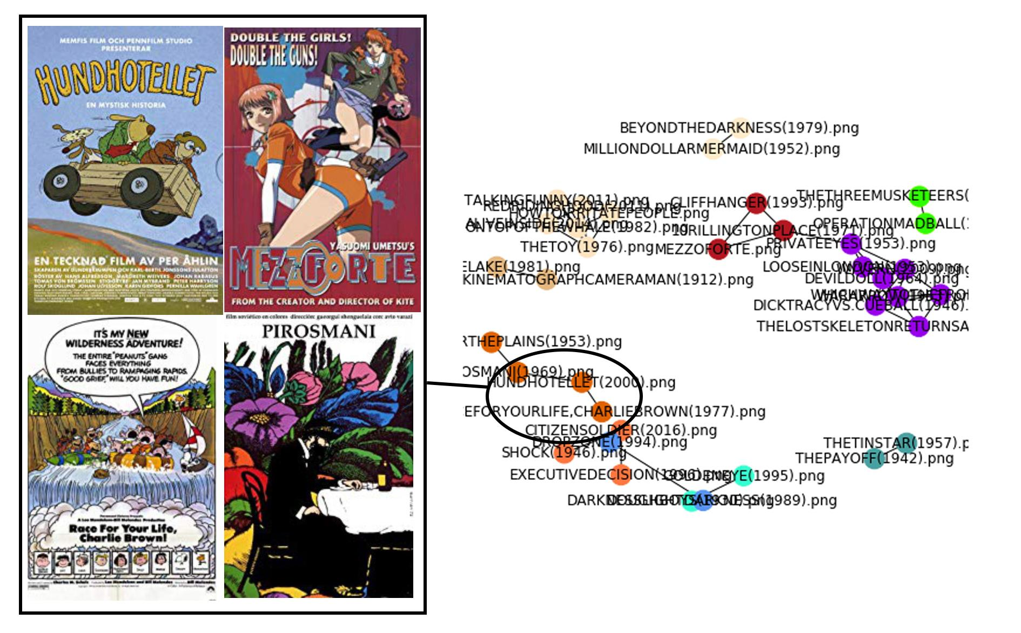
Genre
Repeat the previous process but with posters from different genres

Slide 26
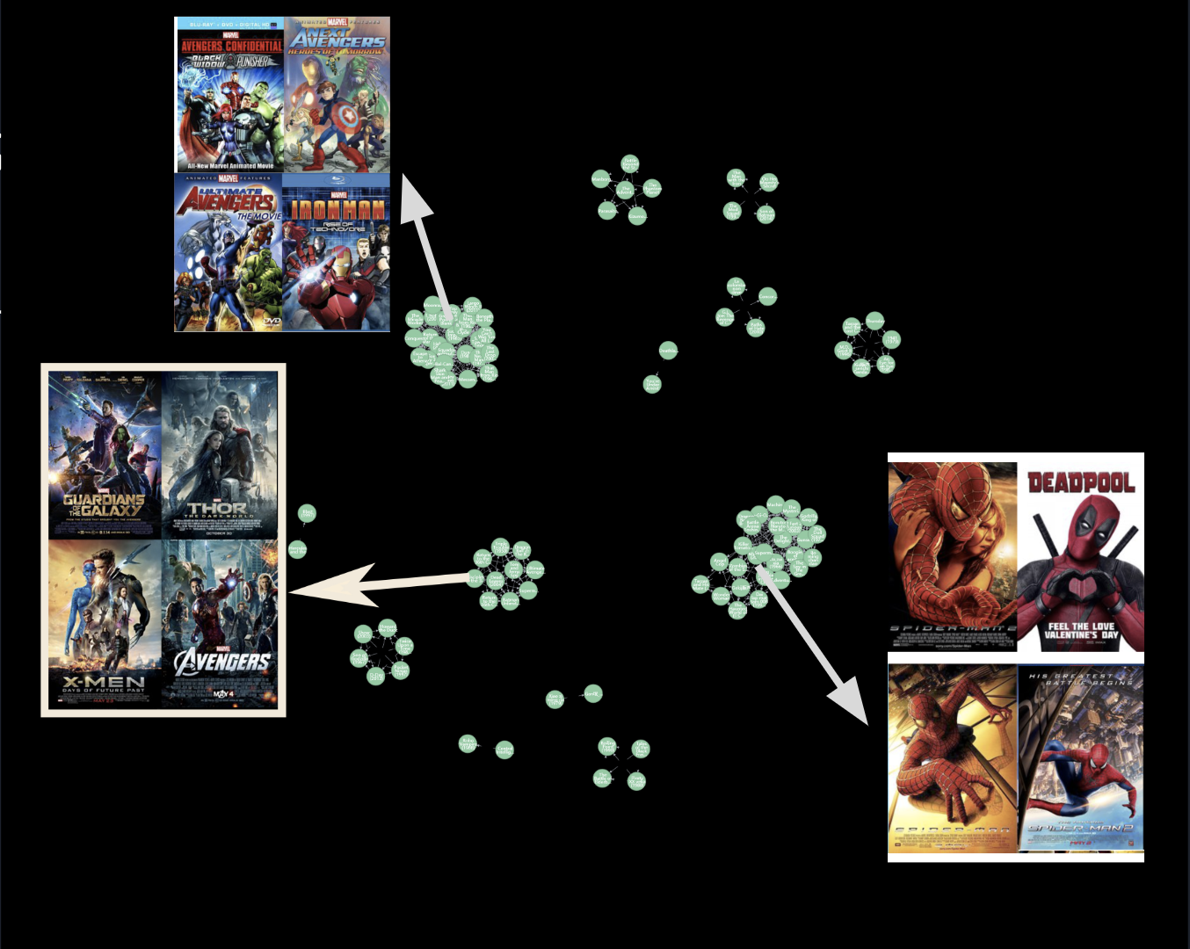
Series
posters from the same movie series may be similar because they have the same background and main characters.
Select all the posters from MARVEL universe.

Slide 27




Extension —— Generating New Poster
Neural Style Transfer Algorithm
Source image
Style
image

Slide 28
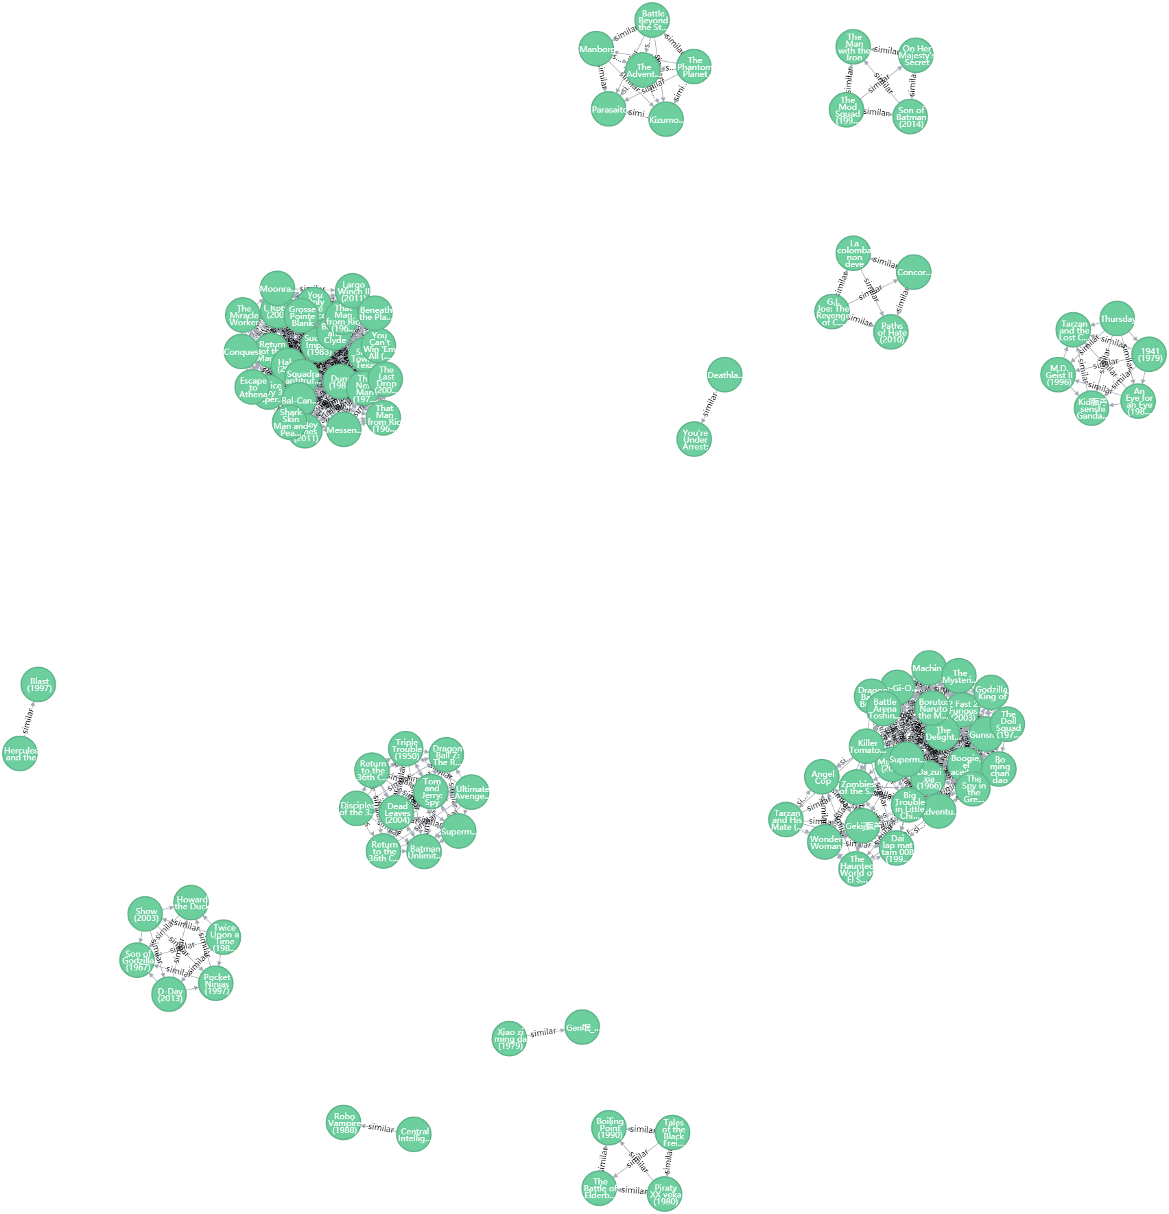
Extension —— Generating New Poster
Collect a certain number of themed movie posters.
Use CD algorithm to get the most representative posters.
Given a content image and a few style images, use NST to produce a new image.

Slide 29


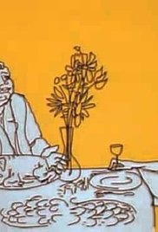





Japanese Animation
Representative Images
...
...

Slide 30
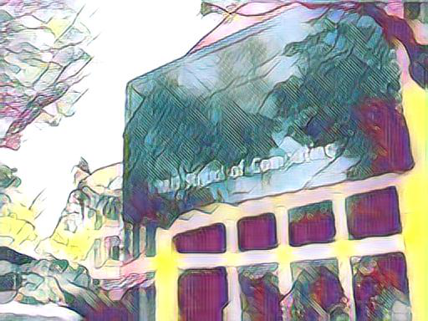


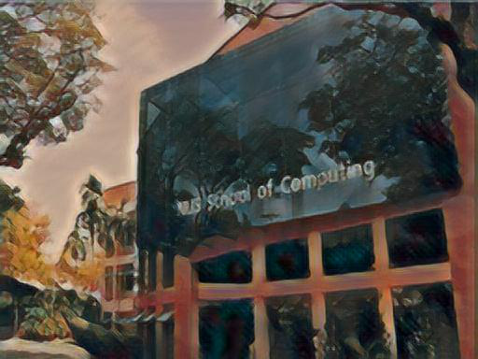
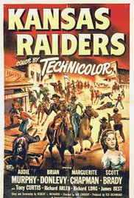
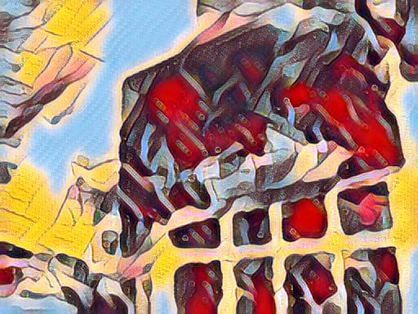

Slide 31
Conclusion
Verified the existence of poster designing cliche.
Found some common design styles among movie posters.
Generate new posters given a certain style.

Slide 32
Lessons Learnt
Research is Hard Work…
but it’s also Rewarding and Cool!

Slide 33
Thank You All

Slide 34
Reference
Neha, Movie Genre from its Poster. (2018) Retrieved from https://www.kaggle.com/neha1703/movie-genre-from-its-poster
Leon A.Gatys, Alexander S.Ecker, Matthias Bethge, A Neural Algorithm of Artistic Style. (2015) Retrieved from https://arxiv.org/abs/1508.06576

